Slide 1
Department for Children and Families
Responding to Vermont’s Opioid Crisis
February 12, 2018
Notes:
The opioid crisis in Vermont poses many challenges for DCF and the families we serve. Particularly, for our Family Service Division who has seen significant increases in the number of children coming into our custody at a very young age. Research has shown that adverse childhood experiences (ACES) such as abuse, neglect, domestic violence, substance use, mental illness, divorce and incarceration can contribute to a wide range of health problems for children throughout their lives including substance use disorders as adults.
Many of the children served by DCF programs are exposed to these stressful and traumatic events. While substance use assessment, treatment and recovery supports are vitally important to adults struggling with opioid addiction, we also need to address the impact opioids have on children. A holistic family-centered approach is needed that provides services and supports to the entire family struggling with opioid addiction. Without these services and supports, we risk a generation of children following in their parent’s footsteps of using substances to mask the pain of trauma left untreated.
My presentation today will highlight the impact of opioids on our programs and families, the model programs and services we have put into place in response to this crisis and recommendations for building on current best practices to create additional services and supports to address the needs of children and families.

Slide 2
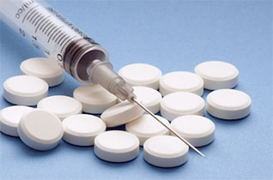
Impact of Opioid Crisis on DCF Services and Families

Slide 3
Family Services Division Impact on Caseload
Since 2013, Family Services Division (FSD) has experienced a 38% increase of children in DCF custody.
Children in DCF Custody
Year | # of Children
2013 | 944
2014 | 1,103
2015 | 1,321
2016 | 1,302
Notes:
Substance use disorders and the opioid crisis is one of the drivers of this increase.

Slide 4
Family Services Division Children in Custody
Notes:
Prior to 2015, FSD had more children between the ages of 13-17 in custody than any other age group.
Since 2015, FSD has had more children between the ages of 0-5 in custody than any other age group.
Based on data collected from FSD staff, the majority of children ages 0-5 are coming into custody because opioids are a factor in their case.
Parents using opiates are unable to provide the safety and care that children need, especially for very young children.

Slide 5
Family Services Division Children in Custody Ages 0 - 5
Number and Percent of Children Ages 0-5 in Custody due to Opiate Abuse Issues
Child’s Age | Nov. 2016 # of children | % of 0-5 children in custody
0 | 46 | 55%
1 | 44 | 44%
2 | 45 | 54%
3 | 53 | 56%
4 | 46 | 62%
5 | 32 | 50%
Total | 266 | 53%
Notes:
53% of the children ages 0-5 in DCF custody is attributed to opiate abuse.
FSD does not have the technology to track cases due to opioid use. These numbers are hand counted by the districts. Technology continues to be a challenge. Tracking kids coming into custody is a metric we need to track in the same way we track opioid overdoses and deaths due to opioid overdoses.

Slide 6
Family Services Division Shifting Caseload
Family Services Caseload Data
Type of Case | June 2014 | June 2015 | June 2016 | May 2017
In DCF Custody | 1087 | 1291 | 1392 | 1303
Conditional Custody Orders | 379 | 485 | 627 | 631
Family Support Cases | 411 | 465 | 455 | 553
Youth on Probation | 152 | 108 | 140 | 128
TOTAL | 2029 | 2349 | 2614 | 2615
Notes:
Number of children in DCF custody has declined slightly since the peak in 2016 of 1,392
Number of Conditional Custody Order and Family Support cases continue to rise. Since 2014:
CCO cases have increased by 66%
Family support cases have increased by 35%
Anecdotally, we believe both these trends are due to opioid use and MAT

Slide 7
Number and Percent of Children 0-5 In Custody Due to Substance Use Issues
Child's Age | Nov-15 | total % of 0-5 Custody Population | Nov-16 | total % of 0-5 Custody Population | Nov-17 | total % of 0-5 Custody Population
0 | 59 | 59.00% | 55 | 66.27% | 42 | 59.15%
1 | 67 | 58.77% | 58 | 58.00% | 54 | 64.29%
2 | 59 | 67.82% | 54 | 64.29% | 62 | 62.00%
3 | 59 | 66.29% | 70 | 73.68% | 37 | 54.41%
4 | 53 | 66.25% | 53 | 71.62% | 64 | 68.09%
5 | 48 | 69.57% | 39 | 60.94% | 37 | 67.27%
Total | 345 | 64.01% | 329 | 65.80% | 296 | 62.71%

Slide 8
Number and Percent of Kids Ages 0-5 In Custody Due to Opiate Abuse Issues
Child's Age | Nov-15 | total % of 0-5 Custody Population | Nov-16 | total % of 0-5 Custody Population | Nov-17 | total % of 0-5 Custody Population
0 | 51 | 51.00% | 46 | 55.42% | 29 | 40.85%
1 | 54 | 47.37% | 44 | 44.00% | 43 | 51.19%
2 | 49 | 56.32% | 45 | 53.57% | 50 | 50.00%
3 | 43 | 48.31% | 53 | 55.79% | 31 | 45.59%
4 | 41 | 51.25% | 46 | 62.16% | 50 | 53.19%
5 | 38 | 55.07% | 32 | 50.00% | 32 | 58.18%
Total | 276 | 51.21% | 266 | 53.20% | 235 | 49.79%

Slide 9
Parent-Child contact survey, Spring 2017
Central office requested all ongoing SWs with a full caseload (not on probation) to complete an 11 question survey
The questions focused on parent-child contact to better understand how many hours are dedicated to supporting monitored family time per week/per ongoing caseload.
69 SWs completed the survey and all districts had responses
Responses are averages and do not include time spent coordinating parent child contact

Slide 10
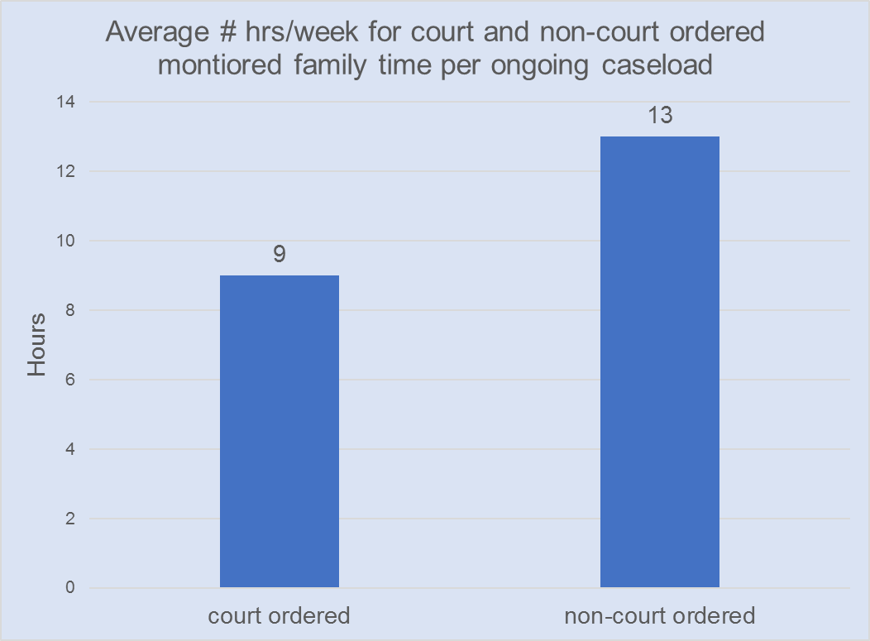

Slide 11
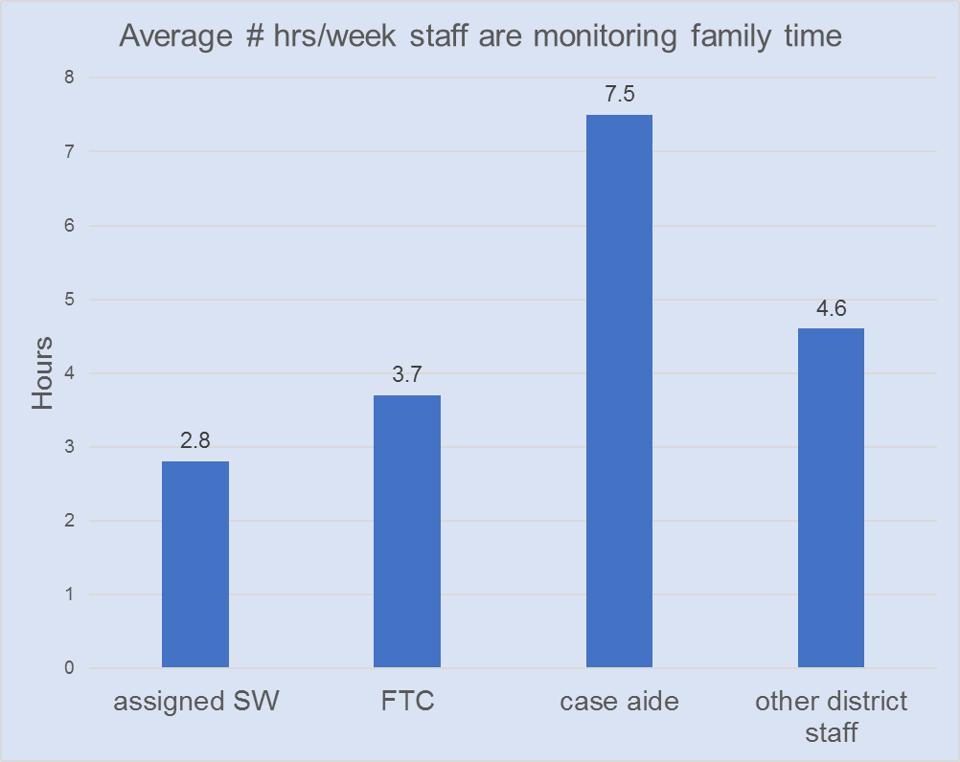

Slide 12
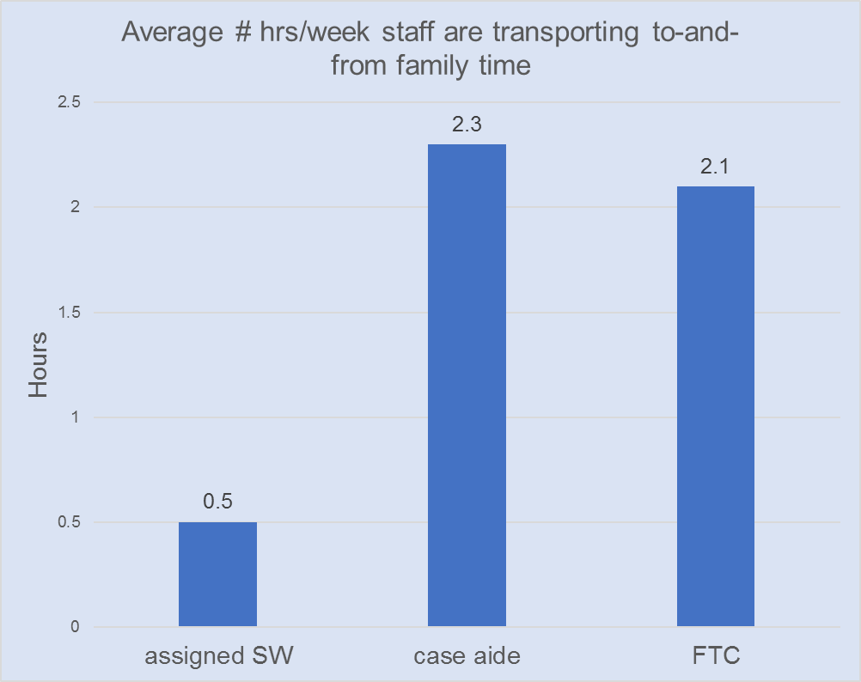

Slide 13
Year | Adoptions of Children in DCF Custody | Adoptions of Children in Conditional Custudy | Subsidized Guardianship | Years Total Children Receiving Subsidy
2017 | 263 | 37 | 16 | 316
2016 | 238 | 12 | 8 | 258
2015 | 179 | 12 | 14 | 205
2014 | 176 | 8 | 13 | 197

Slide 14
Economic Services Division – Reach Up Impact on Caseload
While the Reach Up case load continues to decrease, the Child-Only caseload has remained steady.
Mental health and substance use barriers are reported to make up 25% of the Reach Up caseload.
For those participants that have received 60 months or more of Reach Up, 50% have a mental health or substance use barrier.
In SFY 17 Reach Up’s Medical Review Team approved 788 cases, of those 565 indicated mental health or substance use was a determining factor.
Notes:
Child-only Reach Up provides cash assistance to help eligible adults care for the minor, dependent children of relatives or family friends (FY 16 average monthly caseload of 1,400)
In FY 16 average monthly RU caseload = 3,500 of which 880 have SUD or MH issues
In FY 16 10% of our caseload had over 60 months of assistance

Slide 15
Child Development Division Impact on Services
Children’s Integrated Service (CIS) providers report that between 20-25% of clients served are impacted by a substance use disorder.
Increase in the number of children referred to CIS Early Intervention due to in utero exposure to drugs or born with Neonatal Abstinence Syndrome.
Increase in the number of children referred to CIS due to federal Child Abuse and Prevention Act (CAPTA) requirement that children under age 3 who are in DCF custody be screened for developmental concerns.
Notes:
In utero drug exposure and/or NAS diagnosis makes a child categorically eligible for services under CIS early intervention
Opioids also driving caseloads for CIS

Slide 16
Office of Economic Opportunity Impact on Homelessness
19% of persons who are homeless self-report chronic substance abuse (2017 PIT Count).
In SFY 16, 12% (721) of all persons served by shelters, homelessness prevention and rapid re-housing programs self-reported chronic substance abuse as a disabling condition.
Emergency Shelters estimate that between 30-40% of adults (approximately 3,000 annually) in shelter are in treatment and/or recovery with at least half of those for opioids.

Slide 17
Office of Child Support (OCS) Impact on Caseload
On a typical court day, OCS estimates that between 5% – 40% of child support cases have one parent that is addicted to opioids:
Delinquent child support payments leave a family in need without financial resources.
Courts do not have the ability to order parent into treatment leaving courts with little recourse.
Increase in volume of cases where child does not reside with either parent and lives with a caretaker custodian (CCO cases).
Requires OCS to establish a new court order or to modify an existing order which takes time.
Notes:
When the state takes custody, OCS reviews child support order on a case by case basis. If reunification is the goal, then OCS may not modify the order.

Slide 18
Best Practices at DCF

Slide 19
Family Services Division Best Practice
The Children and Recovering Mothers (CHARM) Team
Key Elements
Pregnancy: Opportunity for Change
Early Access to Prenatal care and Substance Abuse Treatment
Early child welfare involvement, assessment and develop plans of safe care prior to birth
Coordinated Services and Supports
Systems for Collaboration: Information sharing to support health/safety of Moms and infants.
Notes:
Charm is an inter-disciplinary and cross-agency team which coordinates care for pregnant and postpartum mothers with a history of opiate dependence and their babies.
Goal – improve the health and safety outcomes of babies born to women with a history of opiate dependence
Charm team empaneled as a child protection team – allows for information sharing among team members to identify and treat suspected child abuse/neglect.

Slide 20
Family Services Division Best Practice
Updated Child Abuse Report Acceptance Criteria
Worked with the National Center on Substance Abuse and Child Welfare (NCSACW) to review and revise screening policy.
Historically, assumed adequate parenting unless there was an indicator of a lack of care.
Revised policy to assume an impact on parenting when a parent/caregiver has an opioid-related SUD and they are parenting young children.
Notes:
This new criteria may lead to a report being accepted for an assessment or investigation.
Referral for SUD assessment and involvement of LUND RPP Case Manager.
If parent is addressing SUD, FSD engages in safety planning to allow the parent to maintain custody while they access treatment.

Slide 21
Family Services Division Best Practice
Screening for Substance Use Disorder (SUD)
During a Child Safety Intervention, the parent/caregiver receives a screening using the UNCOPE, a substance use screening tool.
If there is a concern is about a possible substance use disorder, the parent/caregiver is referred for a formal assessment.
Notes:
FY 2016 5,536 Safety Interventions conducted
UNCOPE screening tool used by departments and programs across AHS

Slide 22
Family Services Division Best Practice
SUD Screening, Assessment and Testing Policy
Worked with NCSACW to create policy related to screening, assessment and drug testing.
Emphasizes coordination of testing – if it is happening elsewhere (DOC, through existing treatment plan, etc.) policy requires coordination by our staff.
Developed contracts with providers statewide for drug testing.

Slide 23
Family Services Division Best Practice
Implemented LUND Regional Partnership Program (RPP) statewide
LUND Case Managers now work in all 12 district offices:
Screen for substance use disorders (SUD)
Link parents to treatment services
Address barriers to successful engagement with treatment
Notes:
LUND staff work in partnership with Family Services on the front end of the child welfare case to help parents access and engage in SUD treatment.
They provide consultation and information necessary to DCF in assessing child safety as it relates to parental substance use.
LUND has applied for a federal Regional Partnership Grant to expand scope of services. Grant allows for a one-year planning process before implementation so details have yet to be worked out.

Slide 24
Family Services Division Best Practice
FY 17 RPP Data
1,198 parents/caretakers screened by RPP
857 parents/caretakers found at risk of SUD
573 parents/caretakers engaged in SUD treatment
FY 17 RPP Outcomes
84% of participants recommended for an assessment followed through with completing assessment.
82% of participants who completed assessment engaged in SUD treatment.
Notes:
Outcomes show how case management can have a positive impact on helping parent follow through on assessment and treatment

Slide 25
Family Services Division Best Practice
Risk Triage Tool Development
Joint work with ADAP to develop risk triage tool
Tool intended to prioritize wait list for Medication Assisted Treatment (MAT)
Tool captures information about areas of risk:
Housing
Child Protection Involvement
DOC Involvement

Slide 26
Economic Services Division – Reach Up Best Practice
Screening
Reach Up case managers screen all participants using UNCOPE (substance use) and PHQ2 (mental health) screening tools:
Positive results yield a referral to our contracted staff in the Designated Agencies.
The Case Managers/Clinical Case Managers coordinate treatment and team meetings to help foster an environment where participants can focus on their treatment.
Notes:
DA Clinical Case Managers or Case Managers and Clinicians are available onsite in each district office

Slide 27
Economic Services – Reach Up Best Practice
Home Visiting Program
Piloting an evidence-informed curriculum from Nebraska
Mathematica a policy research institution found participants that were involved in this program had improved employment status and improved earnings.
(http://www.buildingbetterprograms.org/wp-content/uploads/2014/04/BNF-Presentation.pdf)
Two of the 12 district offices
Rutland and Newport each have 1 case manager:
Smaller case loads (12-15 participants)
Meet participants in their homes
Curriculum is focused on meeting participants where they are at
Participants choose goals and life skills they want to work on
Notes:
Pilot is in the planning stage – staff have been hired, identifying RU families for the pilot and developing outcome measures

Slide 28
Economic Services Division – Reach Up Best Practice
Temporary Absence
Reach Up supports participants that need to engage in treatment away from the home by continuing to:
Pay for participant’s housing; and
Provide a simultaneous grant to the caretaker caring for the children.
Notes:
180 day rule - allows parent to be absent from the home to receive treatment but continue to receive monthly RU grant for up to 180 days

Slide 29
Economic Services – Jobs for Independence Best Practice
3-Year Pilot Program to research the effects of enhanced services on employment outcomes for 3SquaresVT recipients. Targets 4 groups:
substance use disorders
mental health issues
criminal histories
homelessness
To-date 444 participants (41%) who have been randomly assigned to receive enhanced services identify with having substance use issues
Most participants identify with 2-3 of the 4 target areas
Notes:
Half-way thru pilot, 2,200 participants have enrolled, assigned to either the control group or the enhanced services (treatment) group.
Anecdotally, it appears that strong teaming of multi-disciplinary providers has an overall positive effort on client’s ability to move forward in a positive direction.

Slide 30
Child Development Division Best Practice
Strengthening Families framework promoted across systems serving children and families:
Evidence-based approach
Promotes five protective factors:
Knowledge of parenting and child development
Concrete support in times of need
Social and emotional competence of children
Parental Resilience
Social Connections

Slide 31
Children Development Division Best Practice
Strengthening Family framework has been incorporated into the practices of the Parent Child Centers, Head Start Programs and 24 Promised Communities:
Essential to supporting families in treatment for opioid addiction and as family navigates recovery
Provides concrete supports (cash, transportation, etc.) to support families in treatment
Provides social connections through parenting classes and playgroups beyond the social circle that may draw families back into substance abuse

Slide 32
Office of Economic Opportunity Best Practice
Expansion of Family Supportive Housing – affordable housing and case management and service coordination to address homelessness, substance use disorders, child protection and employment.
FY 2017, 191 adults in the program reported the following outcomes:
25% (47) engaged in SUD treatment
36% (69) receiving mental health services
28% (54) were in recovery
60% (114) maintained sobriety
Notes:
Total of 147 families, 248 children and 191 adults in the program
Another example of why case management services are so crucial to getting parents into treatment and supporting their recovery efforts
90% of families were stably housed in FY 16, dropped to 72% in FY 17 because two new sites opened and families served were homeless during the year

Slide 33
Office of Child Support Best Practice
Work4Kids helps participants to:
Gain work skills and knowledge
Find new or better jobs
Resolve issues that may be keeping them from steady work (e.g., criminal record, mental health issue, substance abuse disorder, no reliable transportation, unstable housing and lack of education/training)
Access supports such as work clothes, transportation and training
Get personal counseling if they need it to stay employed
Modify their child support orders based on their ability to pay
Notes:
Of the 676 cases served to-date, 190 (28%) have been assessed to have substance use/dependence

Slide 34
DCF’s Recommendations to the Governor’s Opioid Coordination Council

Slide 35
Intervention
Expand evidence-based home visiting programs to serve parents with young children ages 0-5 who are engaged in Opioid Treatment:
Maternal Early Childhood Sustained Home visiting (MECSH)
Nurse Family Partnership (NFP)
Parents as Teachers (PAT)
Supports healthy social and emotional development of children while parents are in treatment.

Slide 36
Intervention
Family Services Division
Provide additional visitation resources for more frequent parent/child contact for children in custody:
Transition from 22 part-time, temporary Case Aides to 35 full-time permanent positions in FSD; or
Expand parent child contact contracts to increase numbers served and length of service.
Notes:
The combination of having increased numbers of very young children (0-5) in custody and the prevalence of opioid use has put pressure on FSD for additional visitation resources to support parent child contact and to ensure child safety.

Slide 37
Intervention
Expand Lund Regional Partnership Program (RPP)
Provide 5 additional FTE Case Managers are needed to enhance capacity in 5 districts with caseloads greater than 450 accepted reports per year:
Burlington
St. Albans
Barre
Rutland
Brattleboro
Notes:
Currently have 10 FTE Case Managers for 12 districts

Slide 38
Intervention
Build a Family-Centered Approach to Treatment
A stronger linkage between HUBs and Parent Child Centers would ensure that children impacted by parental substance use disorders receive the support and services they need while parents are engaged in treatment – Two Generational Approach
Notes:
Case management services for the entire family to address parenting and child development in addition to treatment
MA Family Recovery Project – engages parents in intensive home-based treatment for substance use and co-occurring disorders. Facilitates access to existing recovery and treatment supports, achievement of a personalized family plan and involvement in child development, parenting education and social support services.
CT Family-Based Recovery - provides in-home attachment-based parent-child therapy and management of substance use treatment. Services are provided by a team of 2 clinicians and a family support specialist. Services include therapy, relapse prevention, parenting, child development and case management.

Slide 39
Prevention/Intervention
Stable Housing is a Key Social Determinant to Health
To Help Prevent Opioid Use
To Successfully Engage in Treatment
Necessary to Maintain Recovery

Slide 40
Thank you!
For more information or if you have questions, contact me at:
Ken.Schatz@Vermont.gov or via phone at 241-0929
Thank you!

